Slide 1
Lecture 05 Functions
Introduction to Functions
Defining and Calling a Function
Passing Arguments to Functions
Introduction to Value-Returning Functions: Generating Random Numbers
Writing Your Own Value-Returning Functions

Slide 2
Introduction to Functions
Function: group of statements within a program that perform as specific task
  Usually one task of a large program
    Functions can be executed in order to perform overall program task
  Known as divide and conquer approach
Modularized program: program wherein each task within the program is in its own function

Slide 3
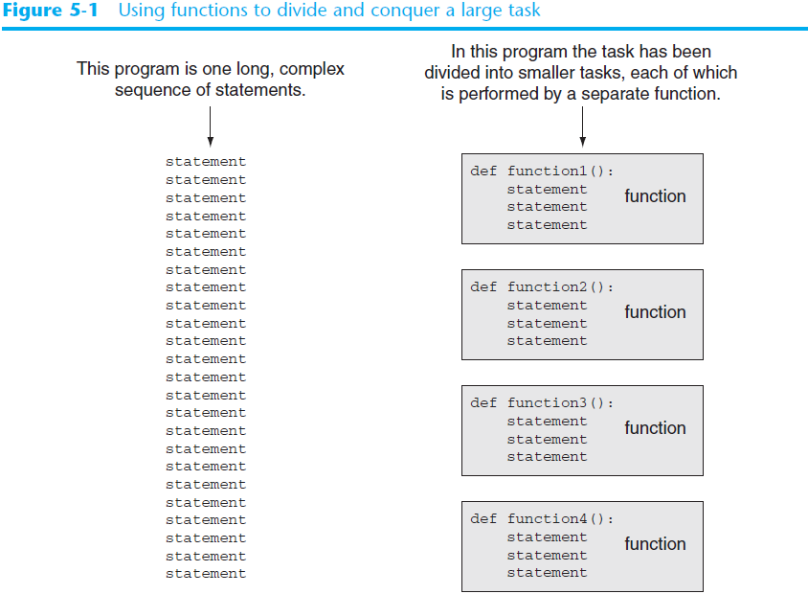

Slide 4
Benefits of Modularizing a Program with Functions
The benefits of using functions include:
  Simpler code
  Code reuse
    write the code once and call it multiple times
  Better testing and debugging
    Can test and debug each function individually
  Faster development
  Easier facilitation of teamwork
    Different team members can write different functions

Slide 5
Void Functions and Value-Returning Functions
A void function:
  Simply executes the statements it contains and then terminates.
A value-returning function:
  Executes the statements it contains, and then it returns a value back to the statement that called it.
    The input, int, and float functions are examples of value-returning functions.

Slide 6
Defining and Calling a Function
Functions are given names
  Function naming rules:
    Cannot use key words as a function name
    Cannot contain spaces
    First character must be a letter or underscore
    All other characters must be a letter, number or underscore
    Uppercase and lowercase characters are distinct

Slide 7
Defining and Calling a Function (cont’d.)
Function name should be descriptive of the task carried out by the function
  Often includes a verb
Function definition: specifies what function does
  def function_name():
    statement
    statement

Slide 8
Defining and Calling a Function (cont’d.)
Function header: first line of function
  Includes keyword def and function name, followed by parentheses and colon

Slide 9
Defining and Calling a Function (cont’d.)
Call a function to execute it
  When a function is called:
    Interpreter jumps to the function and executes statements in the block
    Interpreter jumps back to part of program that called the function
      Known as function return

Slide 10
Indentation in Python
Each block must be indented
  Lines in block must begin with the same number of spaces
    Use tabs or spaces to indent lines in a block, but not both as this can confuse the Python interpreter
    IDLE automatically indents the lines in a block
  Blank lines that appear in a block are ignored

Slide 11
Passing Arguments to Functions
Argument: piece of data that is sent into a function
  Function can use argument in calculations
  When calling the function, the argument is placed in parentheses following the function name

Slide 12
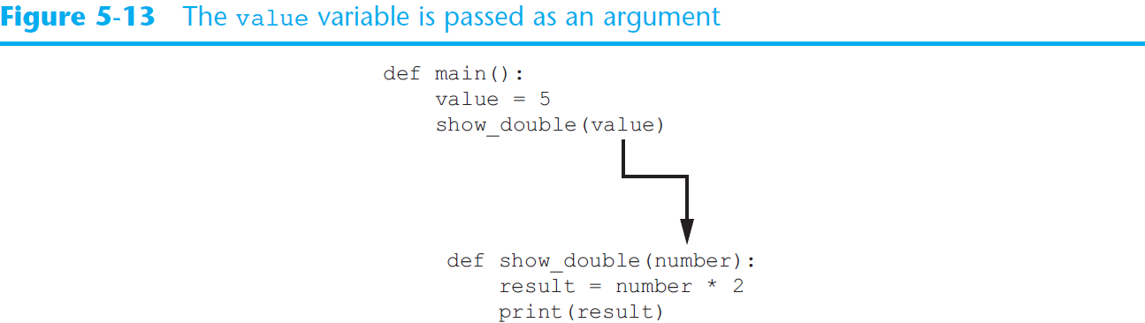
Passing Arguments to Functions (cont’d.)

Slide 13
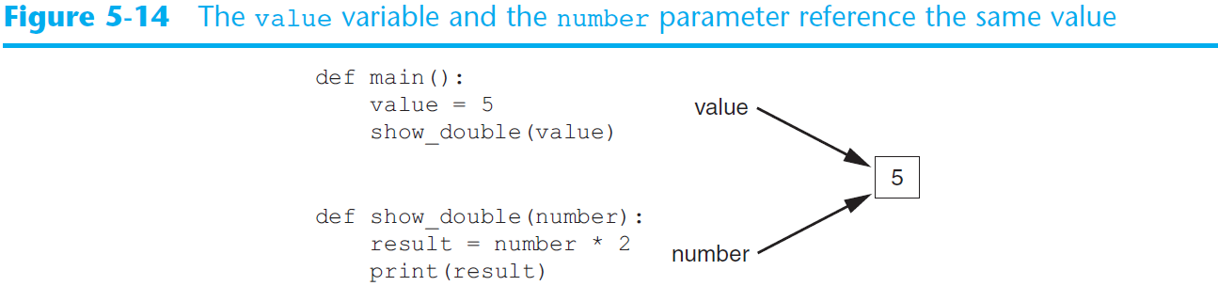
Passing Arguments to Functions (cont’d.)

Slide 14
Passing Multiple Arguments
Python allows writing a function that accepts multiple arguments
  Parameter list replaces single parameter
    Parameter list items separated by comma
Arguments are passed by position to corresponding parameters
  First parameter receives value of first argument, second parameter receives value of second argument, etc.

Slide 15
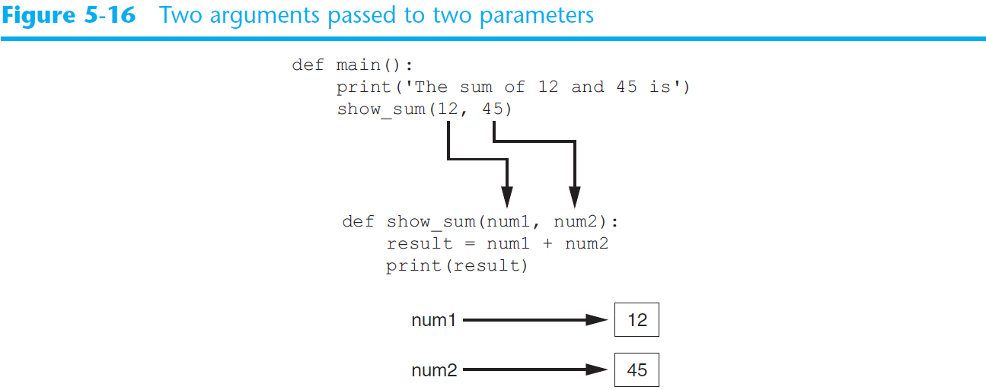
Passing Multiple Arguments (cont’d.)

Slide 16
Writing Your Own Value-Returning Functions
To write a value-returning function, you write a simple function and add one or more return statements
  Format: return expression
    The value for expression will be returned to the part of the program that called the function
  The expression in the return statement can be a complex expression, such as a sum of two variables or the result of another value- returning function

Slide 17
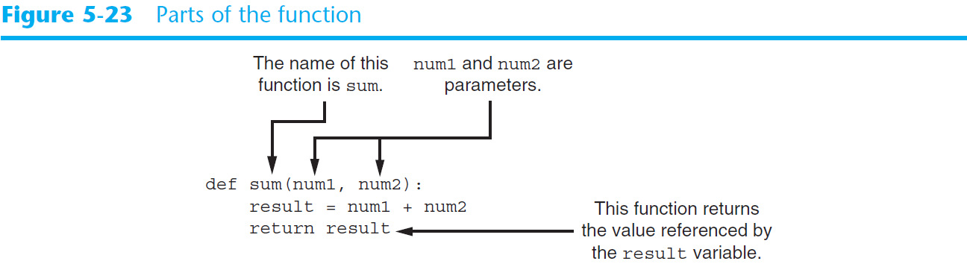
Writing Your Own Value-Returning Functions (cont’d.)

Slide 18
How to Use Value-Returning Functions
Value-returning function can be useful in specific situations
  Example: have function prompt user for input and return the user’s input
  Simplify mathematical expressions
  Complex calculations that need to be repeated throughout the program
Use the returned value
  Assign it to a variable or use as an argument in another function

Slide 19
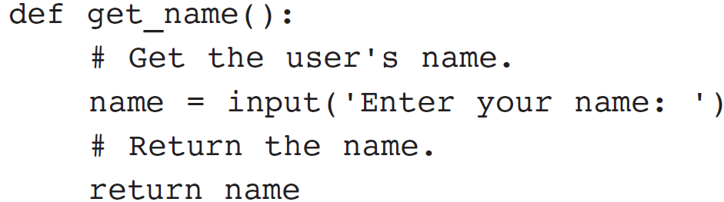
Returning Strings
You can write functions that return strings
For example:

Slide 20
Returning Boolean Values
Boolean function: returns either True or False
  Use to test a condition such as for decision and repetition structures
    Common calculations, such as whether a number is even, can be easily repeated by calling a function
  Use to simplify complex input validation code

Slide 21
Returning Multiple Values
In Python, a function can return multiple values
  Specified after the return statement separated by commas
    Format: return expression1,
    expression2, etc.
  When you call such a function in an assignment statement, you need a separate variable on the left side of the = operator to receive each returned value

Slide 22
Storing Functions in Modules
In large, complex programs, it is important to keep code organized
Modularization: grouping related functions in modules
  Makes program easier to understand, test, and maintain
  Make it easier to reuse code for multiple different programs
    Import the module containing the required function to each program that needs it

Slide 23
Storing Functions in Modules (cont’d.)
Module is a file that contains Python code
  Contains function definition but does not contain calls to the functions
    Importing programs will call the functions
Rules for module names:
  File name should end in .py
  Cannot be the same as a Python keyword
Import module using import statement

Slide 24
Summary
This chapter covered:
  The advantages of using functions
  The syntax for defining and calling a function
  Methods for designing a program to use functions

Slide 25
Summary (cont’d.)
  Value-returning functions, including:
    Writing value-returning functions
    Using value-returning functions
    Functions returning multiple values
  Using library functions and the import statement
  Modules, including:
    The random and math modules
    Grouping your own functions in modules

